Slide 1
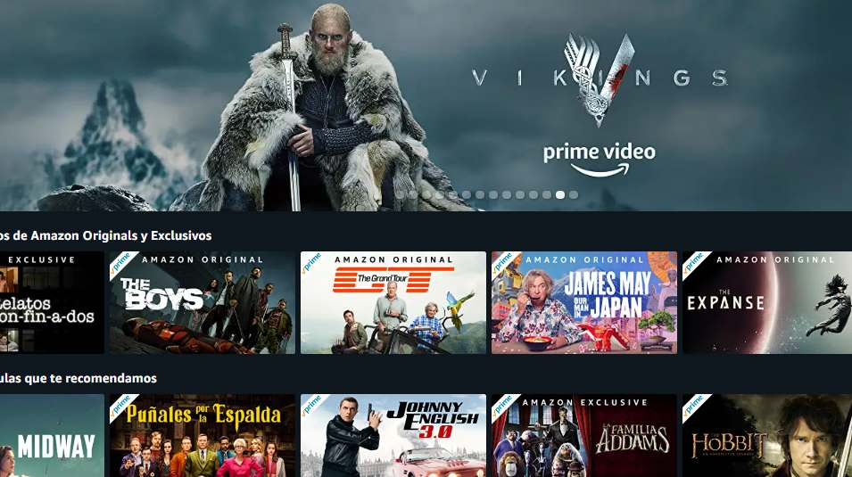


📊 Amazon Prime Video EDA Project

Slide 2
Slide 1: Project Overview
Performed Exploratory Data Analysis (EDA) on Amazon Prime Video’s content library
Dataset includes movies and TV shows with ratings, genres, runtime, age certification, and cast/crew details
Objective: derive business insights to support content strategy and audience targeting

Slide 3

Slide 2: Business Objective
Understand content distribution and growth trends
Identify high‑performing genres and content types
Analyze ratings, popularity, and audience maturity segments
Evaluate the impact of cast and crew on content quality

Slide 4

Slide 3: Dataset Overview Titles dataset: ~9,800 records Credits dataset: ~124k records Key attributes: type, release year, genres, IMDb score, TMDB score, popularity, age certification, country

Slide 5

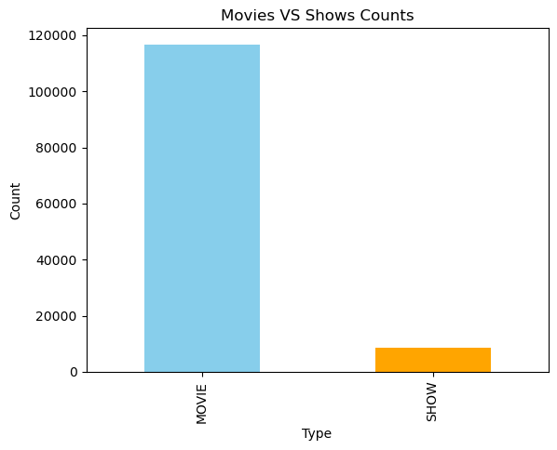
Slide 4: Content Distribution Insights Movies dominate the platform compared to TV shows Consistent growth in content volume over recent decades Indicates platform expansion and increased content acquisition

Slide 6
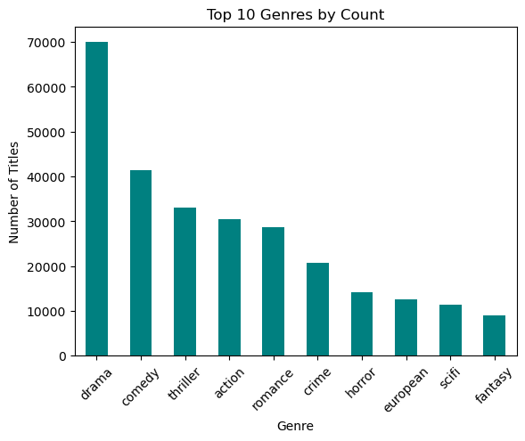
Slide 5: Genre & Audience Insights
Drama and Comedy are the most common genres
Thriller and Documentary genres show rising trends
Genre analysis helps identify audience preferences

Slide 7
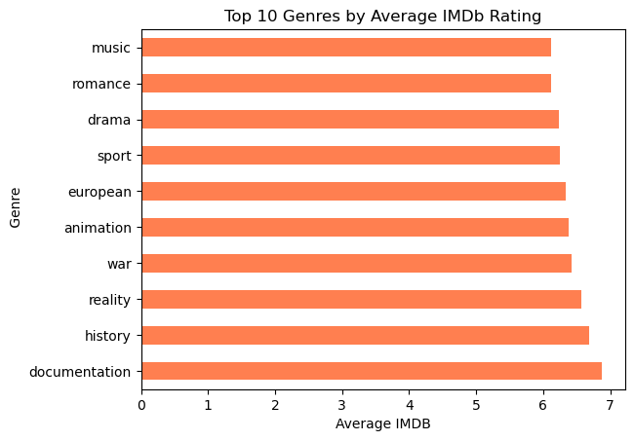
Slide 6: Ratings & Popularity Analysis
Strong correlation between IMDb and TMDB ratings
Higher popularity generally aligns with higher vote counts
Identified top‑rated and most‑engaged titles

Slide 8
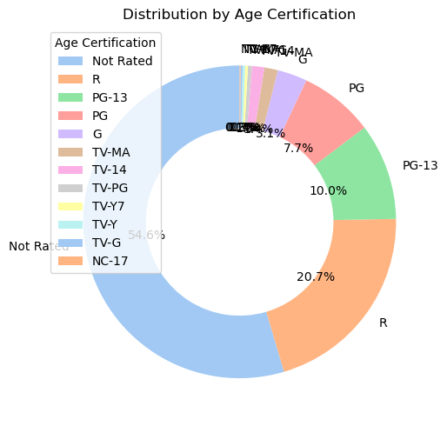
Slide 7: Age Certification Analysis
Majority of content targets mature audiences
Family and general‑audience content still form a significant portion
Helps in audience segmentation and compliance‑aware planning

Slide 9
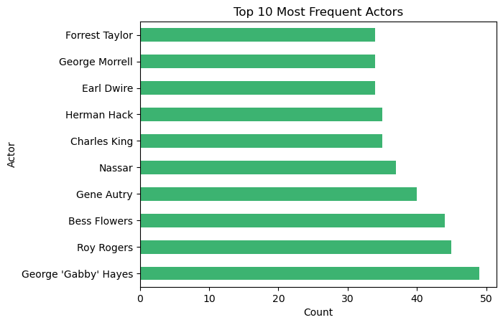
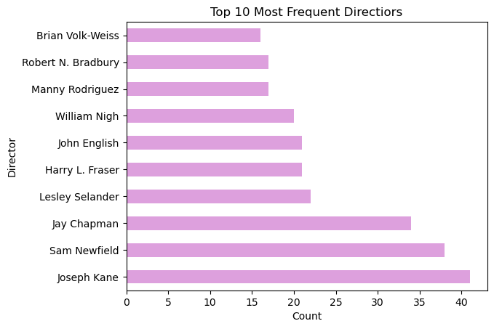
Slide 8: Cast & Crew Impact
Certain actors and directors appear frequently across titles
Their associated content shows higher average ratings
Highlights the role of talent in content performance

Slide 10

Slide 9: Key Takeaways
Amazon Prime maintains a diverse and global content library
Data‑driven insights can guide smarter content investments
Analysis supports strategic decisions in production and acquisition

